Slide 1
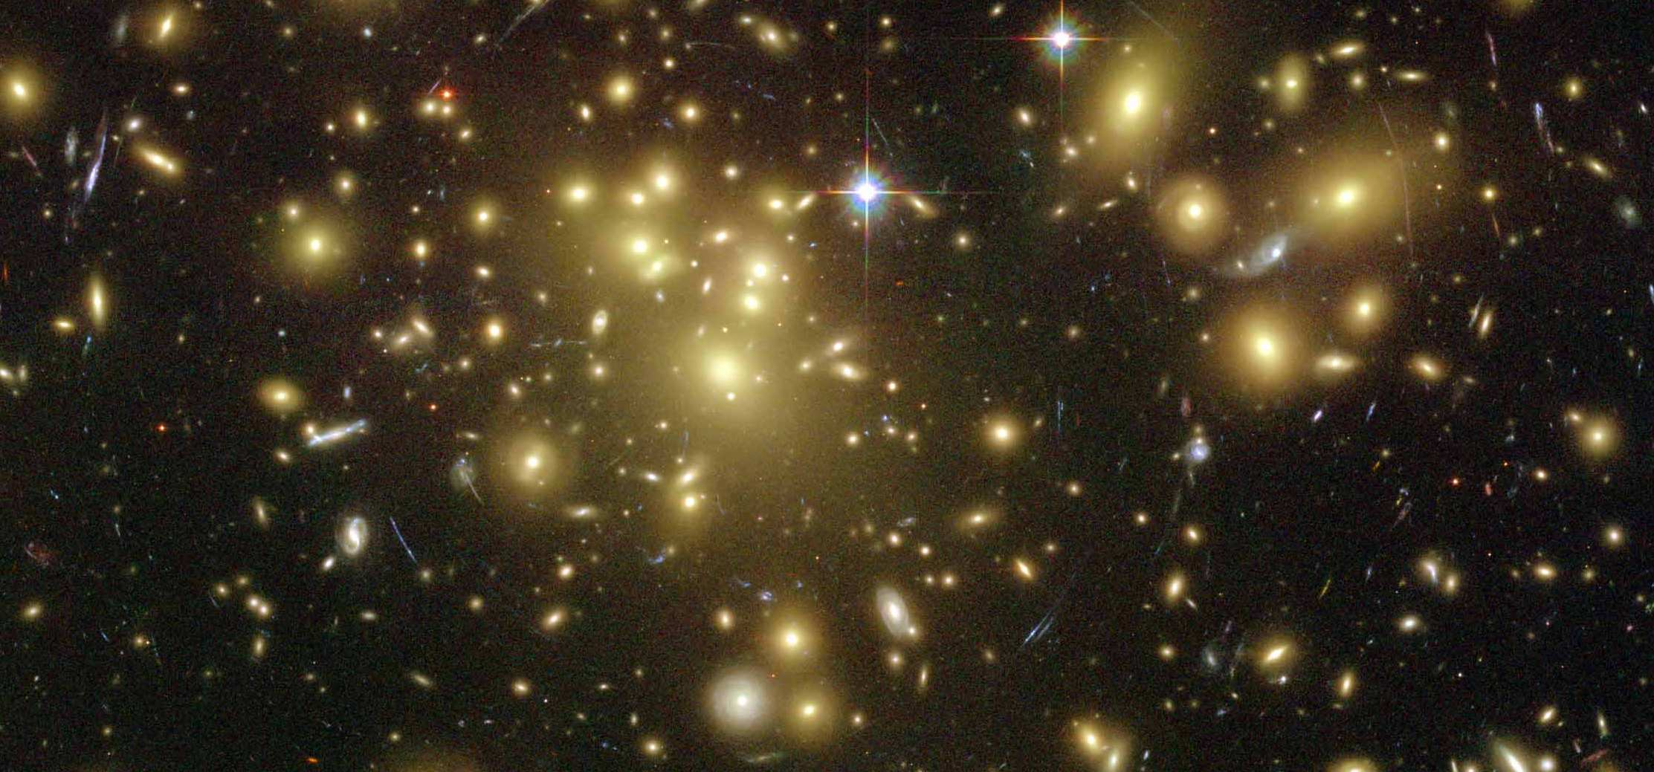
Fourier_Quad，a Shear Measurement Method in Fourier Space
Jun Zhang (张骏)
(Shanghai Jiao Tong University)
Collaborators:
Fuyu Dong, Hekun Li, Yingke Li, Xiangchong Li, Tianhuan Lu, Wentao Luo, Xiaohu Yang, Pengjie Zhang, Yipeng Jing (SJTU); Dezi Liu, Zuhui Fan (PKU); Liping Fu (SHNU); Guoliang Li (PMO); Nobuhiko Katayama (IPMU).
CEA Saclay, Oct 4, 2018

Slide 2
Outline:
The Fourier_Quad method
Application on the CFHTLenS data
Summary

Slide 3
Outline:
The Fourier_Quad method
Application on the CFHTLenS data
Summary

Slide 4
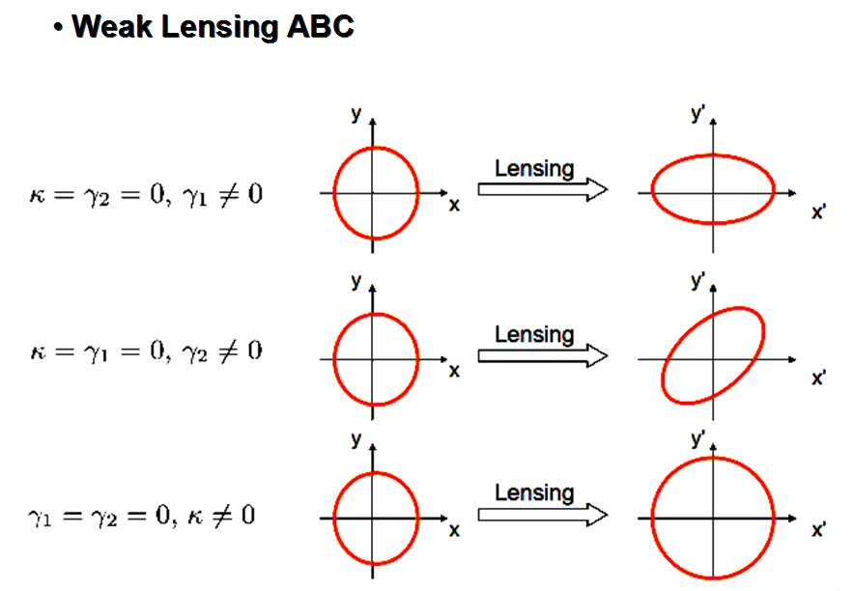

Slide 6
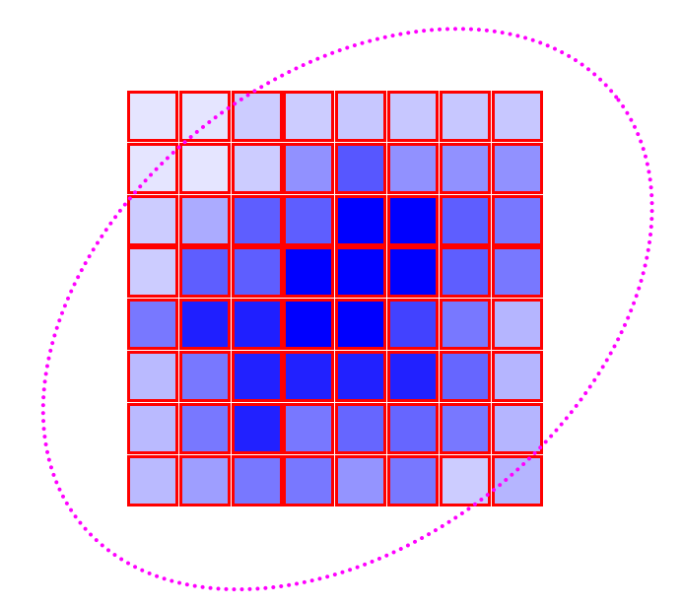
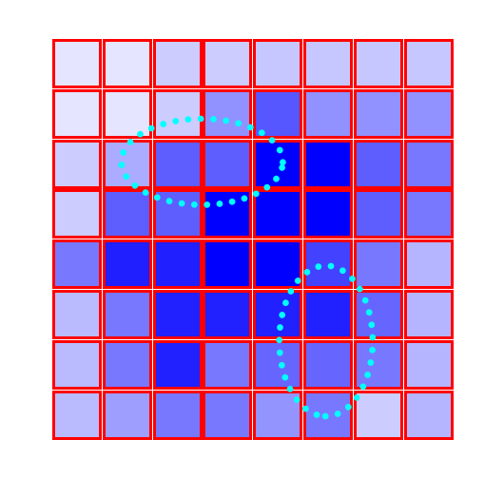
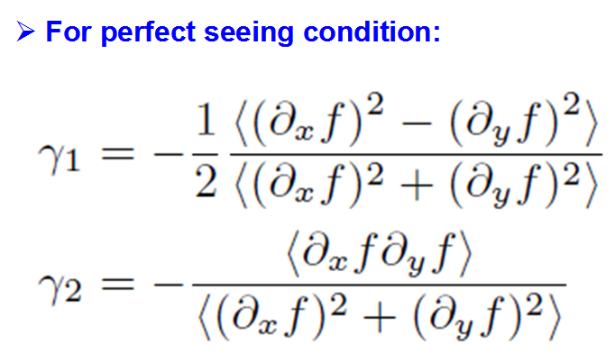
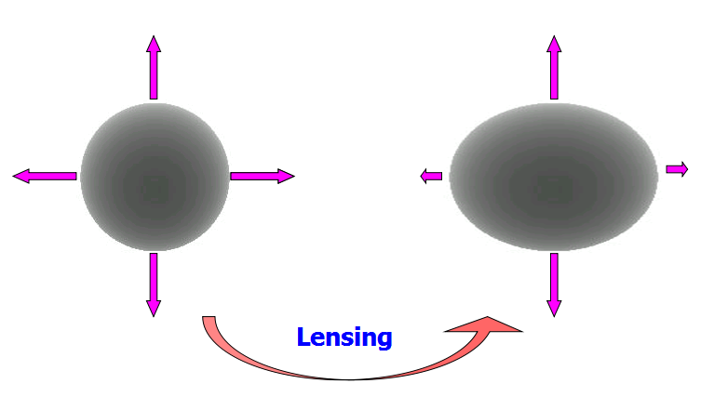
A Different Way to Measure Shear
Seljak & Zaldarriaga, 1999

Slide 7
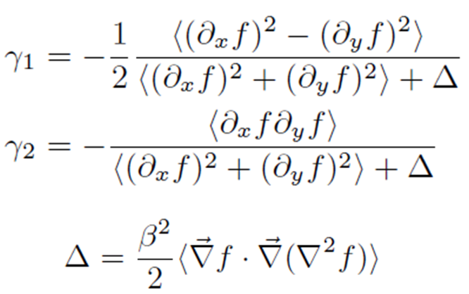
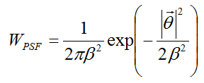
A Different Way to Measure Shear
In the presence of an isotropic Gaussian PSF
JZ,MNRAS,383,113(2008)

Slide 8
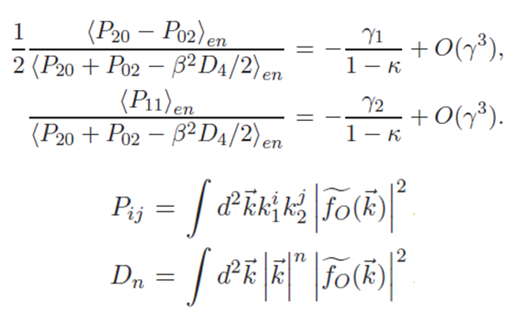
A Different Way to Measure Shear
Formulae in Fourier Space
JZ,JCAP,11,041(2011)

Slide 9
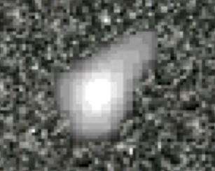
Regarding the Background Noise
JZ,MNRAS,403,673(2010)

Slide 10
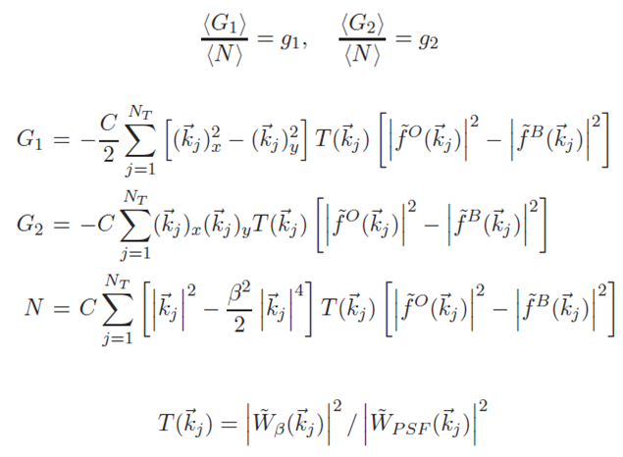
Removing the Background Noise (statistically)
JZ,Komatsu,MNRAS,414,1047(2011)

Slide 11
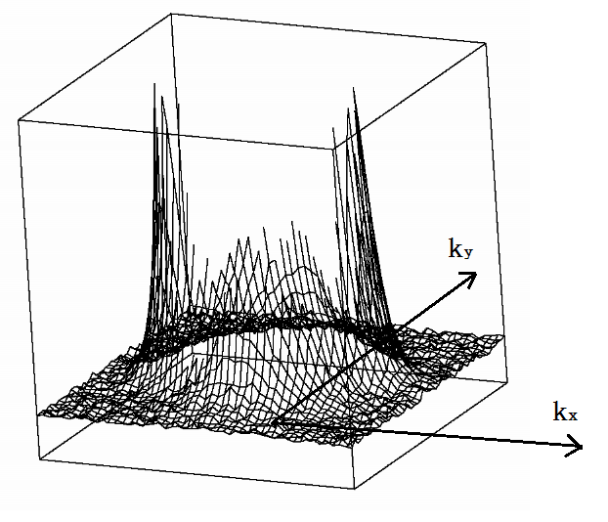
Regarding the Poisson Noise
JZ,Luo,Foucaud,JCAP,01,024(2015)

Slide 12
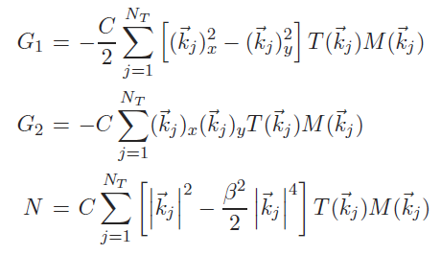
The Final Form of Shear Estimator
JZ,Luo,Foucaud,JCAP,01,024(2015)

Slide 13
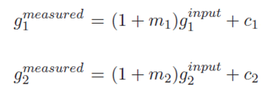
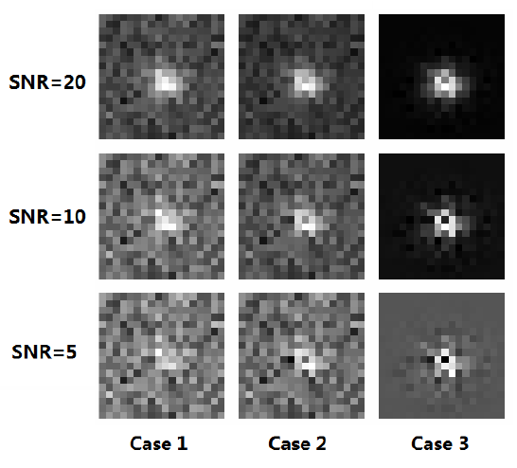
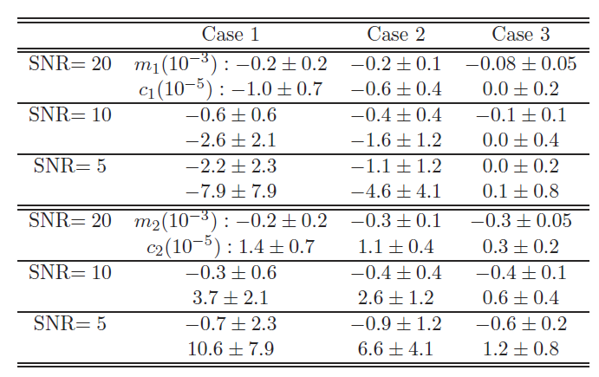
Test Results
JZ,Luo,Foucaud,JCAP,01,024(2015)

Slide 14
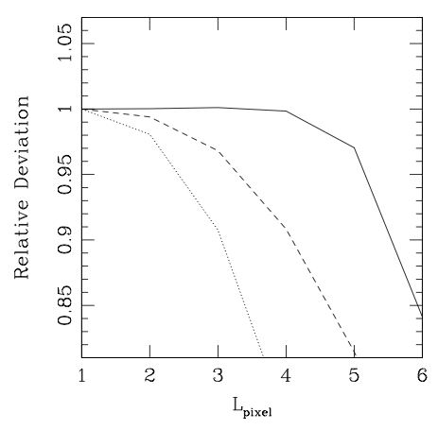
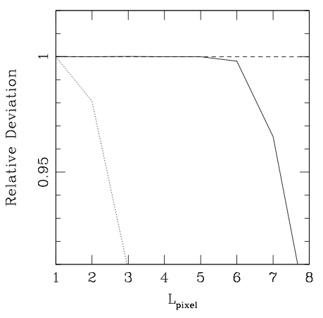
Regarding the Pixelation Effect
Equivalent to Whittaker–Shannon (sinc) interpolation
Moffat PSF
Gaussian PSF
FWHM of both PSF = 12
JZ,JCAP,11,041(2011)

Slide 15
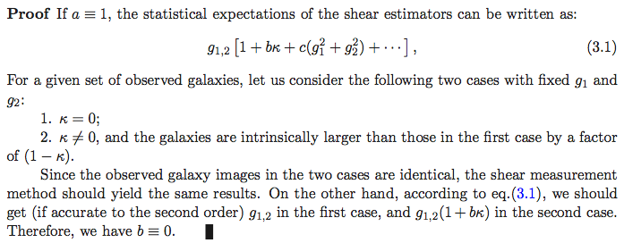
Regarding the Reduced Shear
Theorem: ,
JZ,JCAP,11,041(2011)

Slide 16
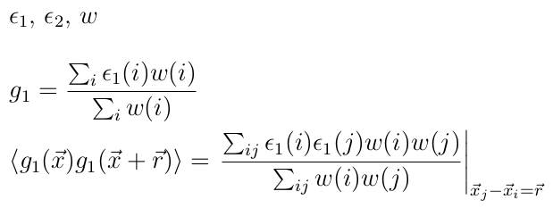
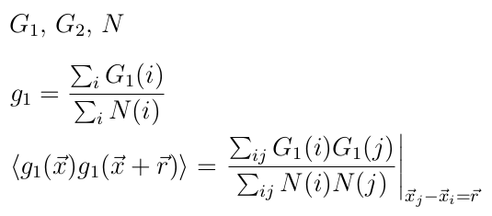
Regarding the Shear Statistics
Order One
Nonnegative
Conventional Form:
~ 0± for faint sources
New Form:
JZ,Komatsu,MNRAS,414,1047(2011)

Slide 17
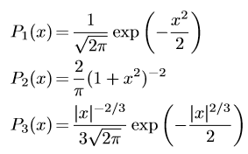
Approaching the Cramer-Rao Bound
C-R BOUND
Examples
JZ,Zhang,Luo,ApJ,834,8(2017)

Slide 18
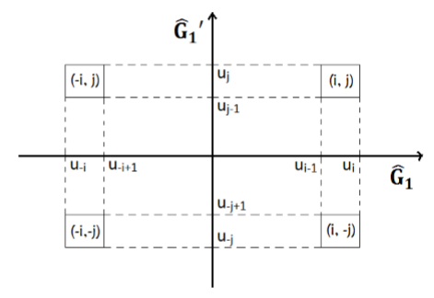
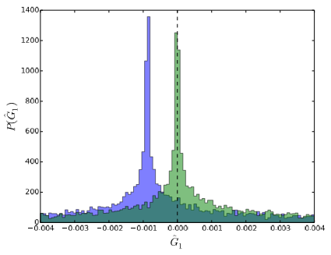
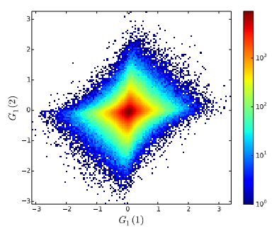
Approaching the Cramer-Rao Bound
JZ,Zhang,Luo,ApJ,834,8(2017)

Slide 19
Outline:
The Fourier_Quad method
Application on the CFHTLenS data
Summary

Slide 20
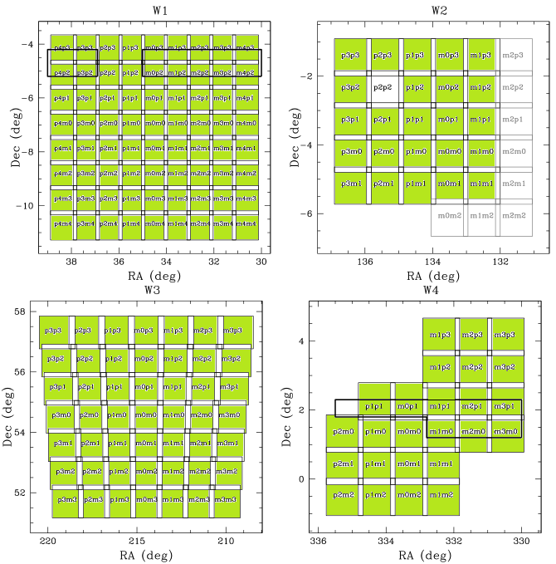
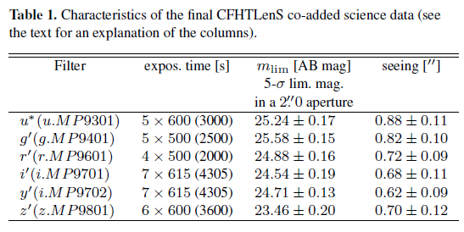
Application on the CFHTLenS data
CFHTLenS
http://www.cfhtlens.org
Erben et al (2012)
Heymans et al (2012)
Miller et al (2012)

Slide 21
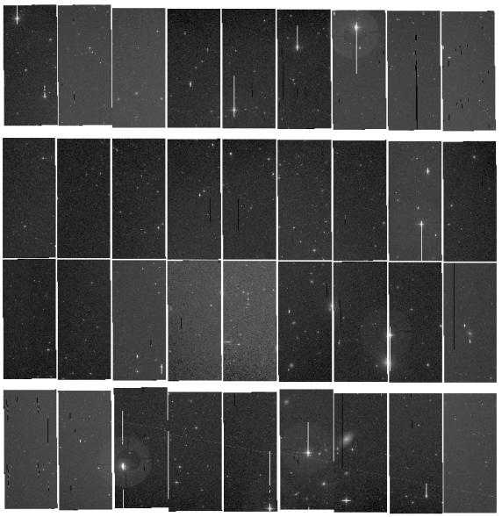
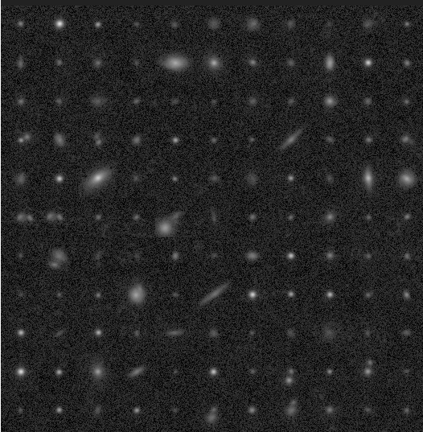
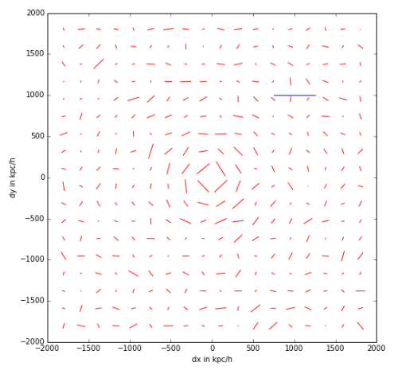
Application on the CFHTLenS data
Single Exposure
Source catalog
Shear Catalog
We have developed an accurate shear measurement pipeline. Starting with almost raw CCD images (after flat-fielding correction), our code does background removal, masking, astrometric calibration, cosmic ray identification, source selection, PSF reconstruction, shear measurement, etc.. The overall speed is around 0.02 CPU•sec/galaxy, which is about 100 times faster than typical model-fitting methods.

Slide 22
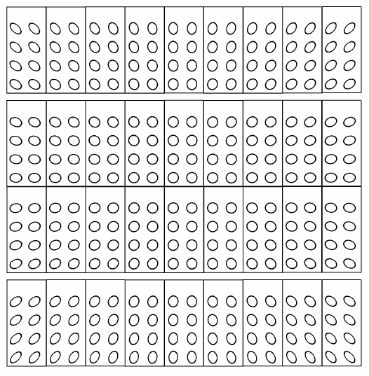
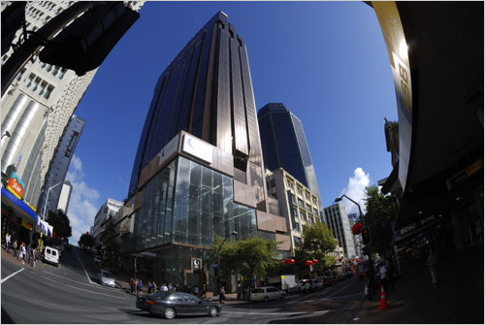
Test Shear Recovery with Field Distortion
Right：FD distribution on MegaCam, enlarged by 30 times.

Slide 23
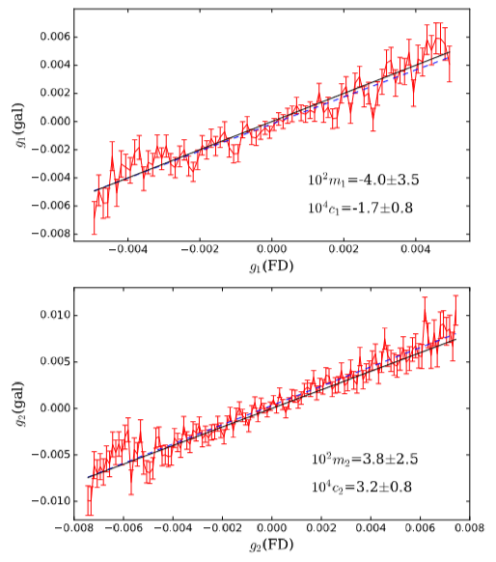
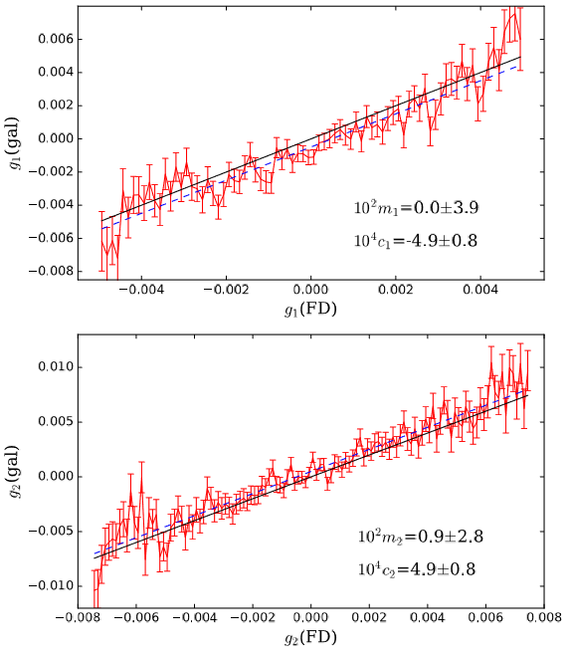
Test Shear Recovery with Field Distortion
With our own source catalog
With CFHTLenS source catalog
JZ et al., arXiv:1808.02593

Slide 24
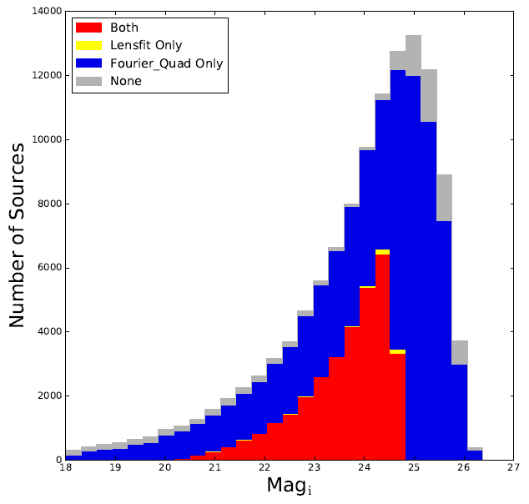
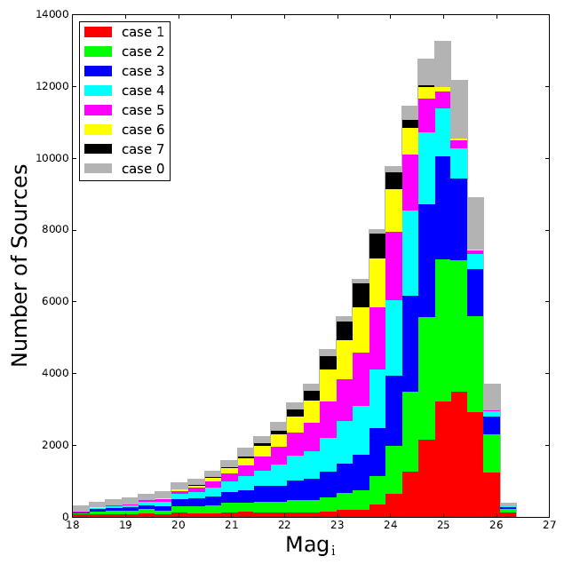
A Brief Comparison with Lensfit

Slide 25
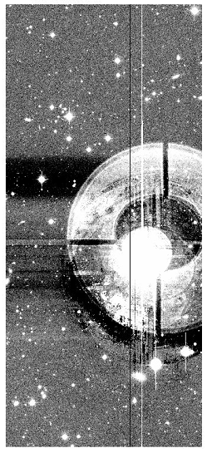
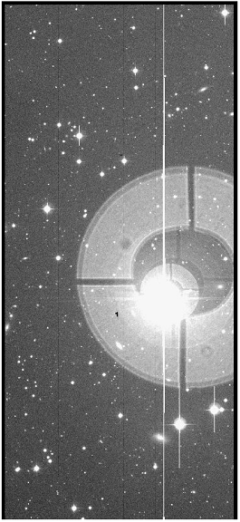
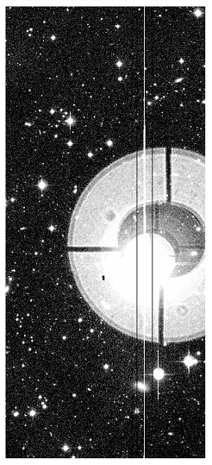
Problems in Background Removal
THELI Processed
Original Image
We Processed

Slide 26
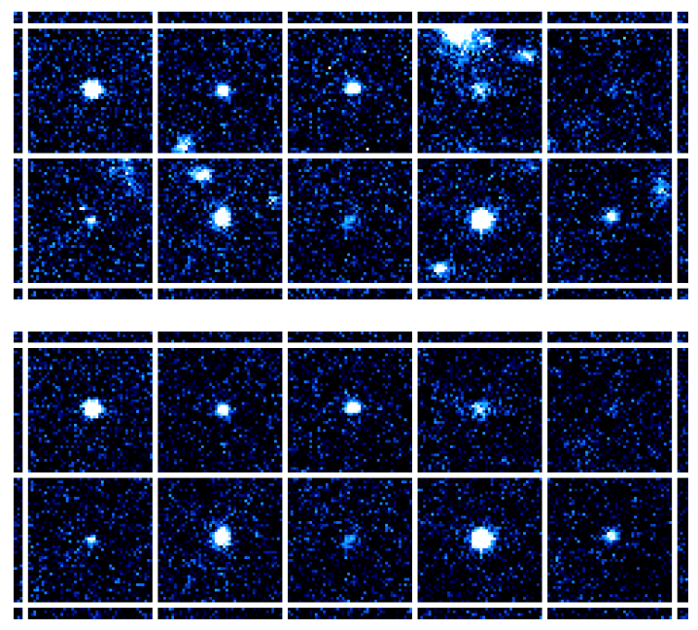
Deblending
source stamps
deblended

Slide 27
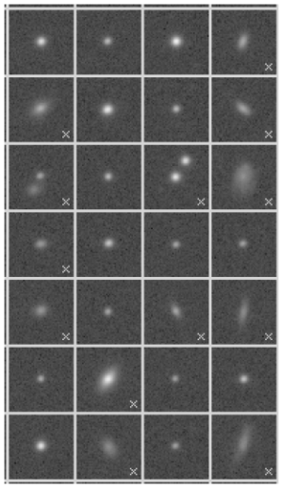
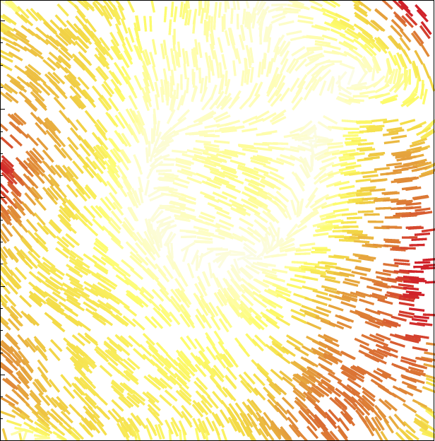
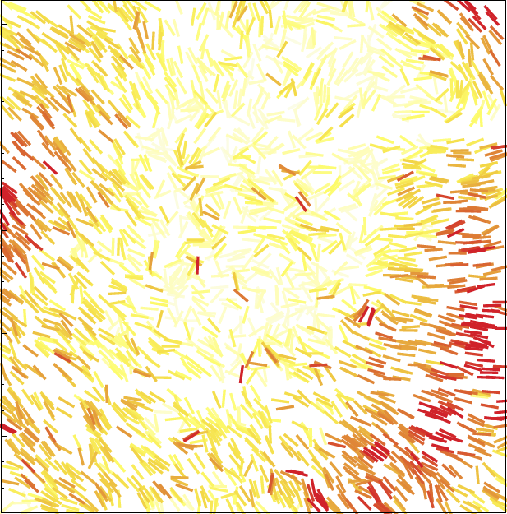
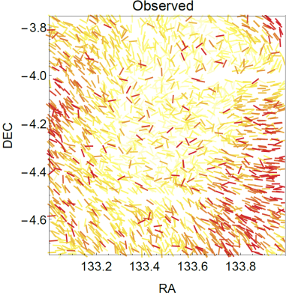
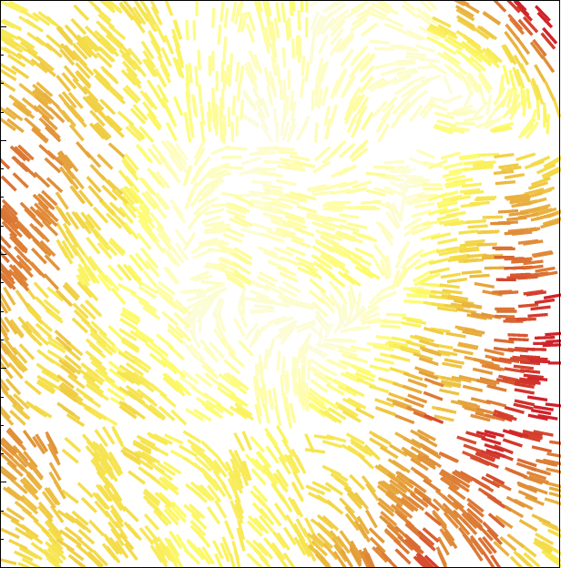
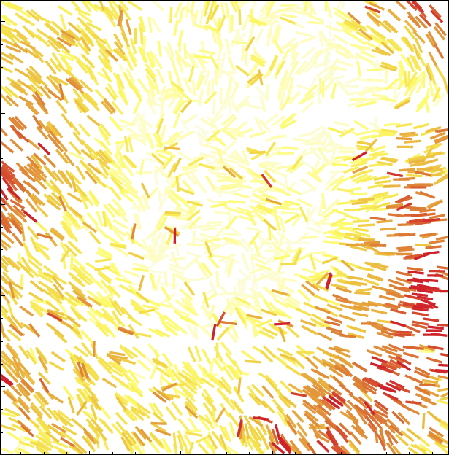
PSF Reconstruction（Find Bright Stars，Build PSF）
Global Polynomial n = 10
Kriging
Chipwise Polynomial n = 1
Shepard
Lu, et al. , 2017, AJ, 153, 197

Slide 28
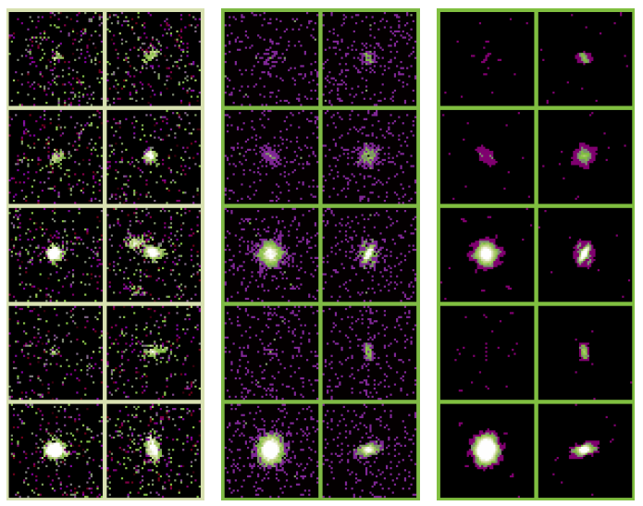
Noise Reduction
Source Images
Their PS
Noise-reduced PS

Slide 29
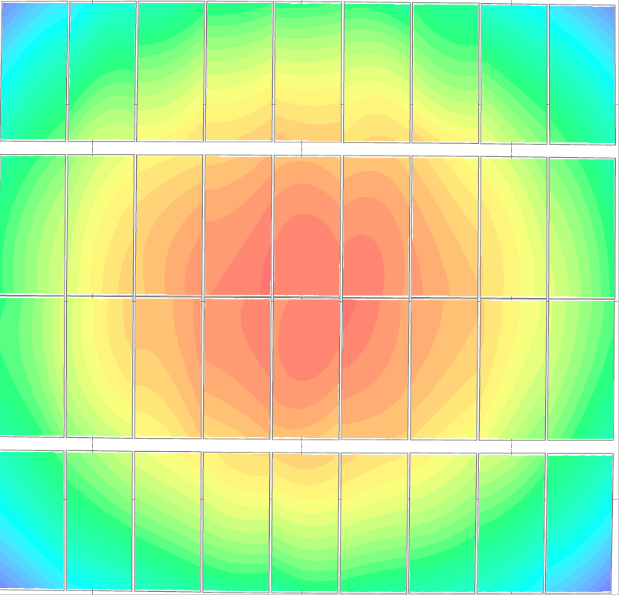
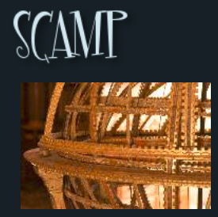
Accuracy of Astrometry
?

Slide 30
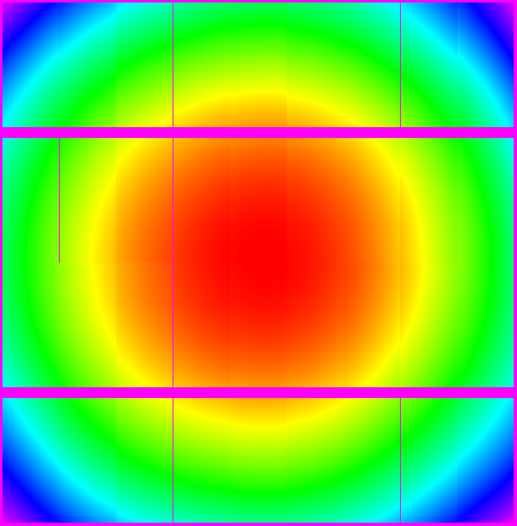
Accuracy of Astrometry (with our code)

Slide 31
Accuracy of Astrometry ( a new idea )

Slide 32
Accuracy of Astrometry ( a new idea )

Slide 33
Accuracy of Astrometry（Pattern Matching）
Reference (Gaia)
Target CCD

Slide 34
Accuracy of Astrometry（Pattern Matching）

Slide 35
Accuracy of Astrometry（Pattern Matching）
△Y
△X

Slide 36
Accuracy of Astrometry（Pattern Matching）
△Y
△X

Slide 37
Accuracy of Astrometry（Pattern Matching）
△Y
△X

Slide 38
Accuracy of Astrometry (with our code)
3rd order polynomial fit
9th order polynomial fit

Slide 39
About PSF Interpolation
Global Polynomial n = 10
Kriging
Chipwise Polynomial n = 1
Shepard
Lu, et al. , 2017, AJ, 153, 197

Slide 40
About PSF Interpolation
Lu, et al. , 2017, AJ, 153, 197

Slide 41
About PSF Interpolation
Heymans et al., 2012, MNRAS, 421, 381

Slide 42
About PSF Interpolation
Lu, et al. , 2018, ApJ, 858, 122

Slide 43
Outline:
The Fourier_Quad method
Application on the CFHTLenS data
Summary

Slide 44
Summary
The Fourier_Quad method is an efficient and accurate way of measuring shear. It has the following advantages:
Correct for the PSF effect model-independently;
Exact & Simple Math;
Statistically exact removal of the contamination from the background and source Possion noise;
Accurate to the 2nd Order in shear/convergence;
Immune to misidentification of stars as galaxies;
Fast data processing speed: ~ 10⁻² CPU*sec/Gal;
Shear statistics can approach the Cramer-Rao Bound.

Slide 45
Stay Tuned ! Thank You !

